Slide 1
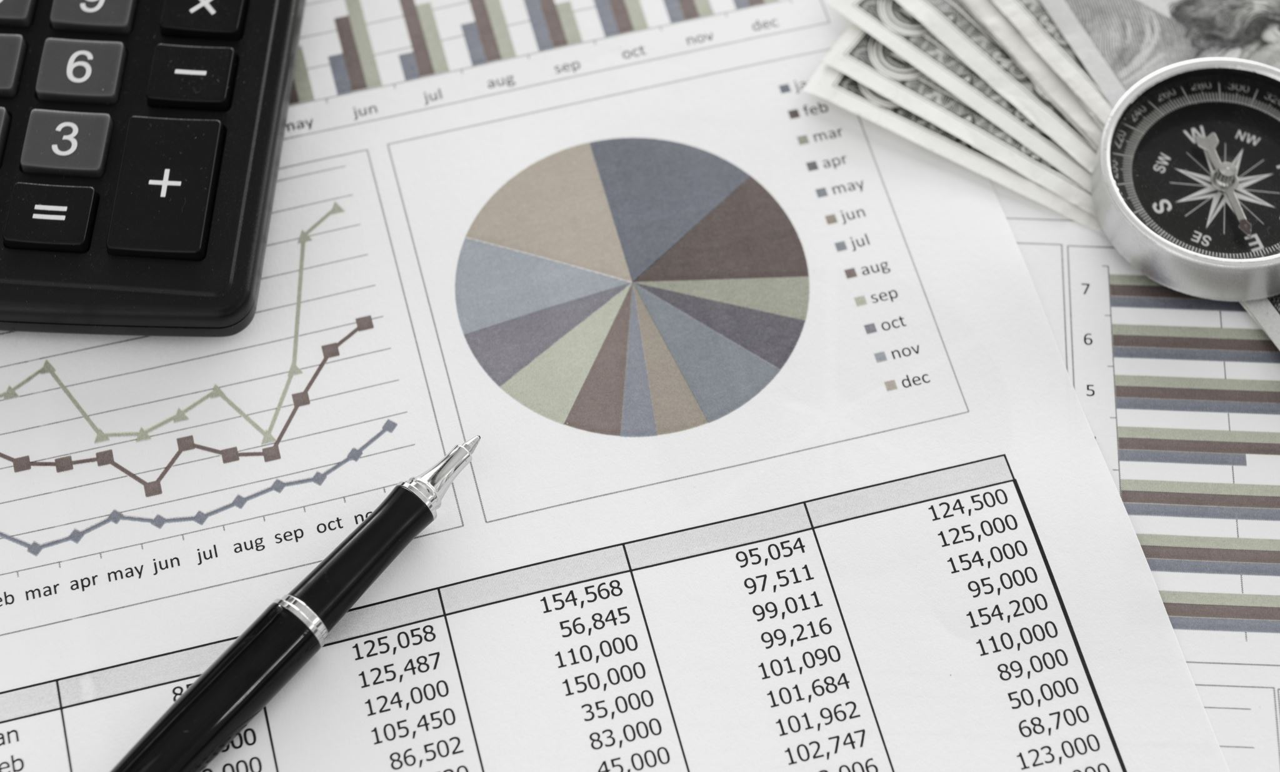
RfM Analysis
Shraddha Saha

Slide 2

Contents
Objective
Key concepts
Data Collection
Tools used
Workflow
Insights

Slide 3
objective
A start-up company named “EVStore India” sells EVs, batteries, and charging accessories online and through dealerships.
The marketing team wants to segment customers based on their purchasing behavior (Recency, Frequency, and Monetary) to identify:
High-value loyal buyers
One-time buyers
Recently active buyers
At-risk or churned customers
Revenue generators etc.

Slide 4
Key concepts
RFM Analysis stands as a pivotal tool in customer segmentation strategies, delving into the dynamics of Recency, Frequency, and Monetary Value; used in marketing, CRM, and e-commerce analytics to identify customer value and behavior based on purchase history.
It measures how recently, how often, and how much a customer spends.
RFM Analysis becomes imperative when businesses seek to understand and categorize their customer base according to purchasing behavior and patterns. Through the application of RFM Analysis, businesses can finely tailor their marketing strategies, ensuring that messages and offers are personalized to each segment. This refined approach ultimately leads to heightened levels of customer acquisition, retention, and conversion rates.

Slide 5
Key concepts
Recency | Frequency | Monetary
How recently did the customer last make a purchase? | How often does the customer make purchases? | How much money has the customer spent on purchases?
Recency = (Reference Date) – (Customer’s Last Purchase Date) | Frequency = Count of orders per customer | Monetary = total money spent by each customer
Smaller Recency = Better (customer bought recently) | Higher frequency = better customer loyalty. | Higher monetary = more valuable customer.

Slide 6
Data collection
We have four CSV files named
“Customers.csv”
“products.csv”
“orders.csv”
“order_items.csv”

Slide 7
Tools used
For RFM Analysis, we worked on MYSQL Workbench to write queries on Structured Query Language.

Slide 8
Workflow
Let us see the next few slides how we made the data preparation in MYSQL workbench to get the data for RFM analysis.
Schema Preparation
Data Import
Create necessary virtual tables
Start RFM analysis

Slide 9
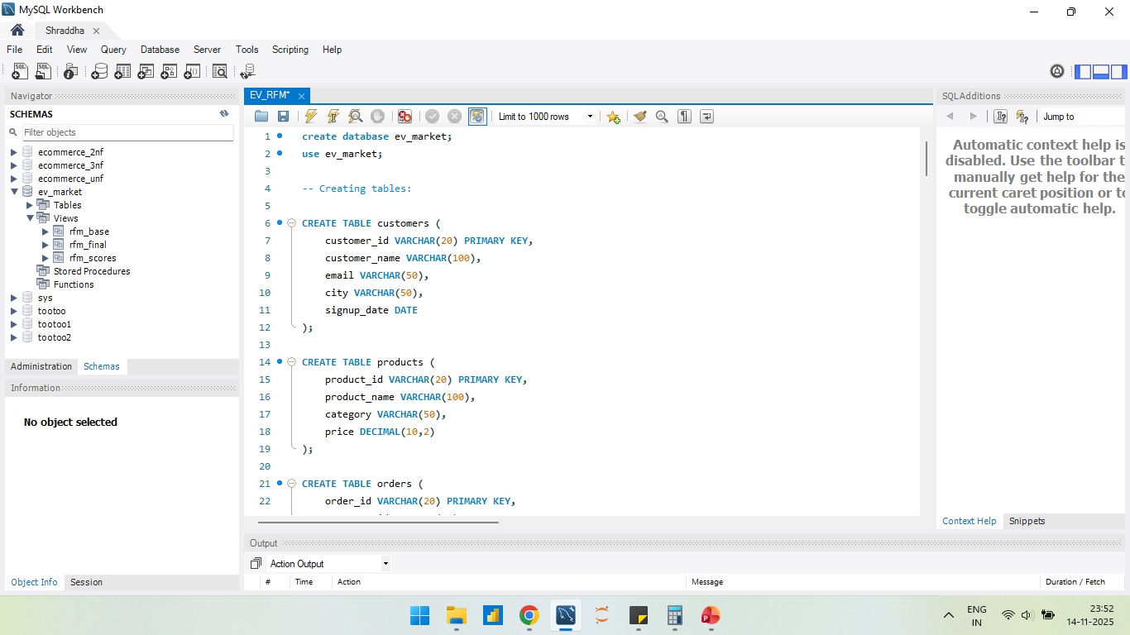
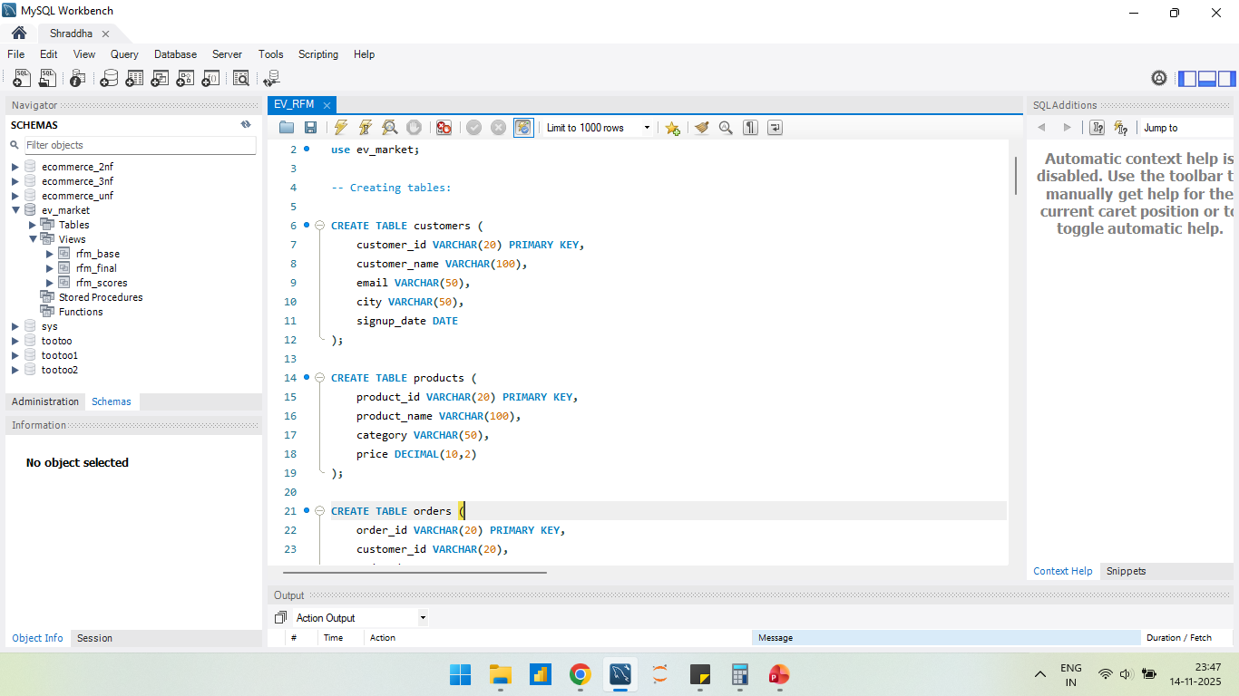
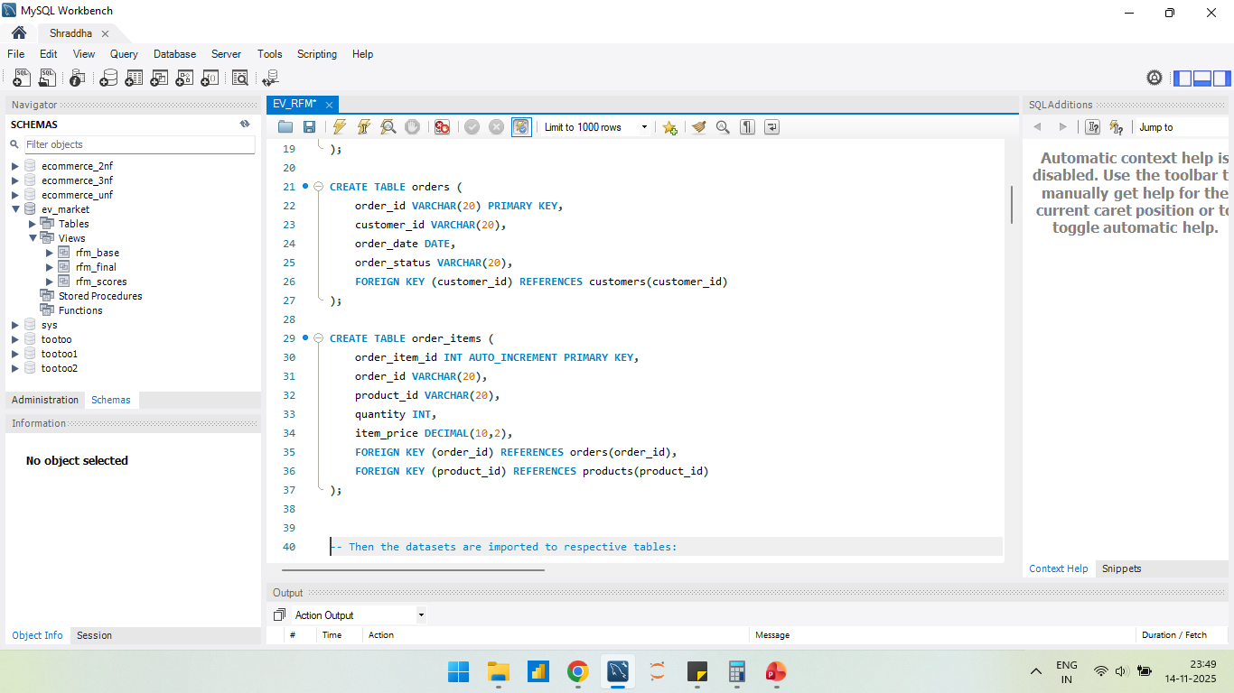
Schema Preparation
First created a database dedicated for this project only.
Next The DDL queries are written for creating four different tables.

Slide 10
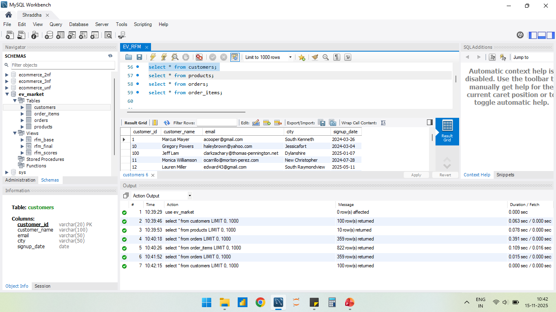
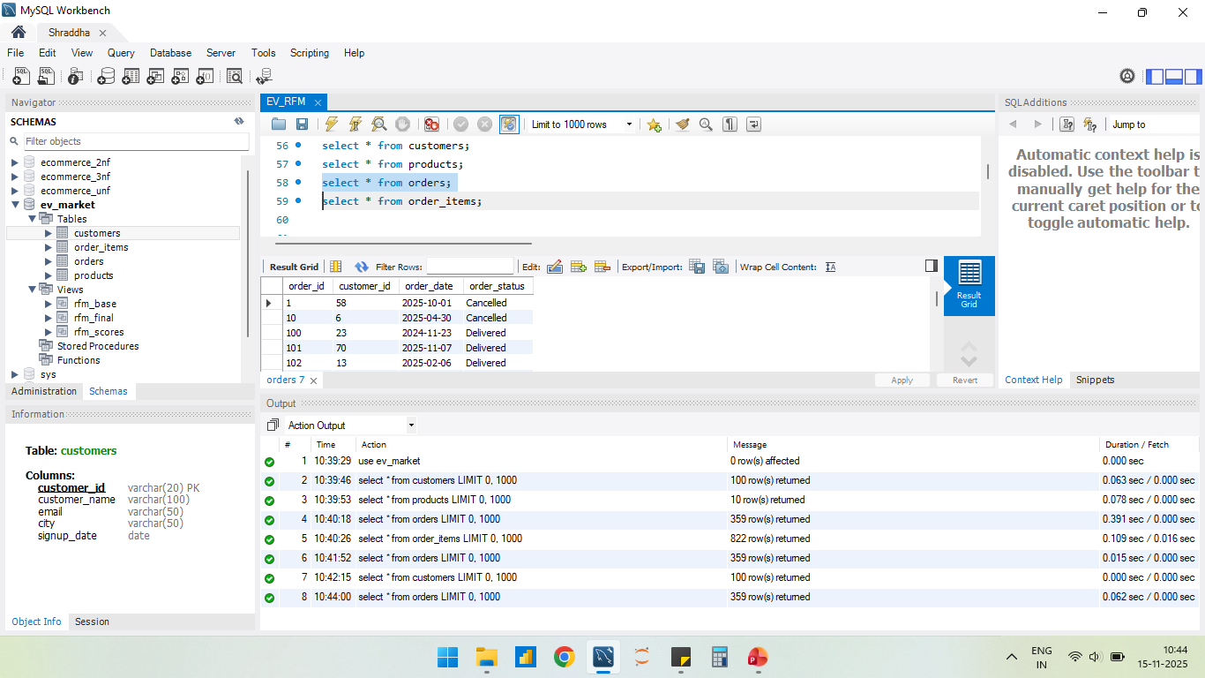
DATA IMPORT
Then imported the four CSV files in the same order of table creation in database.
Here are the customers and orders tables shown below , rest two are also uploaded correctly in database.

Slide 11
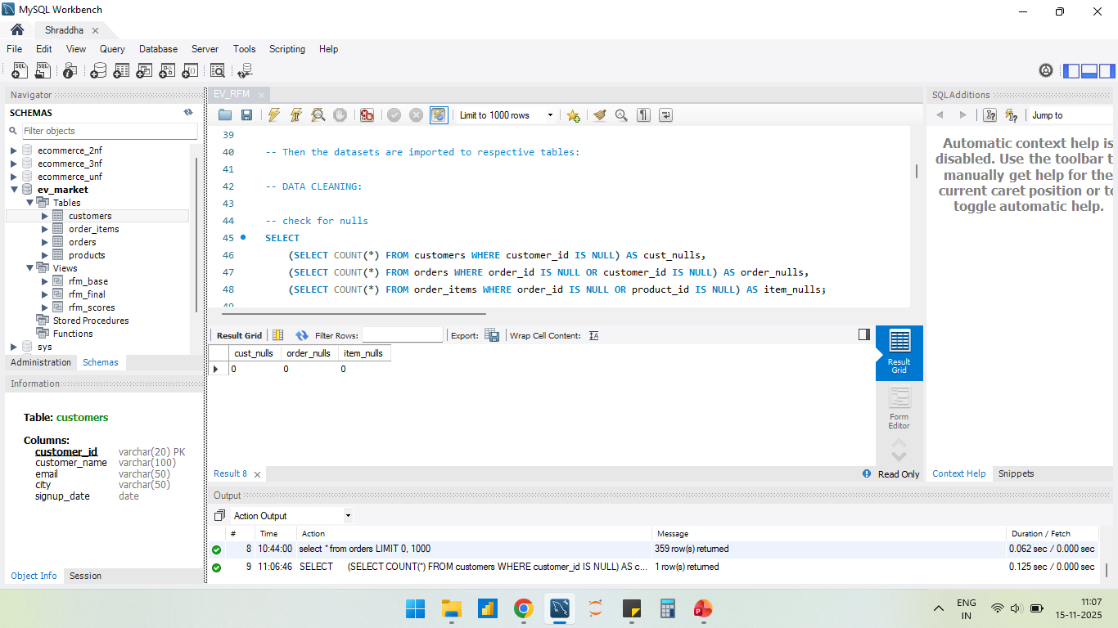
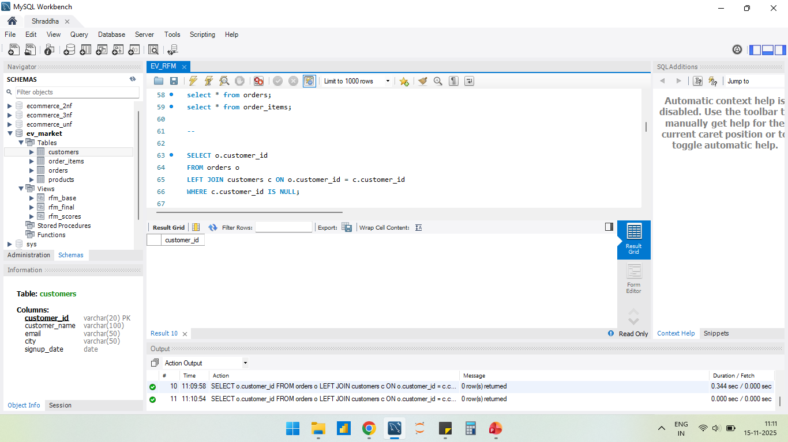
DATA CLEANING CHECKS
Here are some cleaning checks on the data.

Slide 12
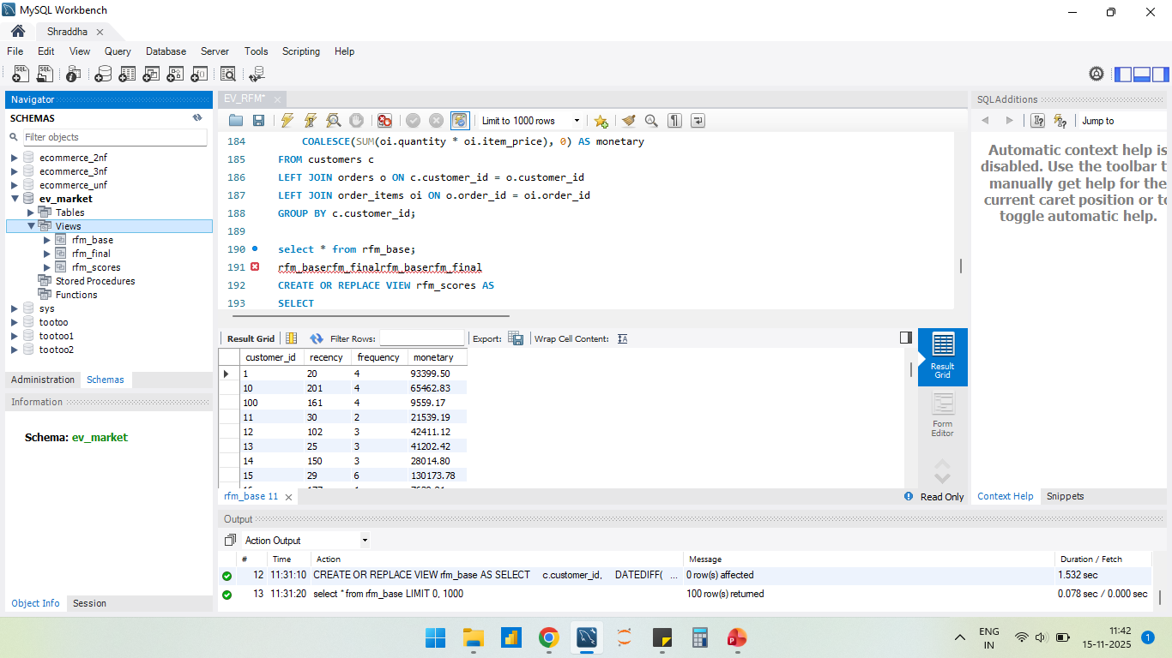
Creating VIEWS
Now to work easily on RFM analysis, we started with creating three views in the database.
A View is a virtual table created from a SQL query. It does not store actual data — it stores only the query definition. When you select from the view, MySQL runs the underlying query and returns the result.
These following three are the views created which we will discuss in next slides:

Slide 13
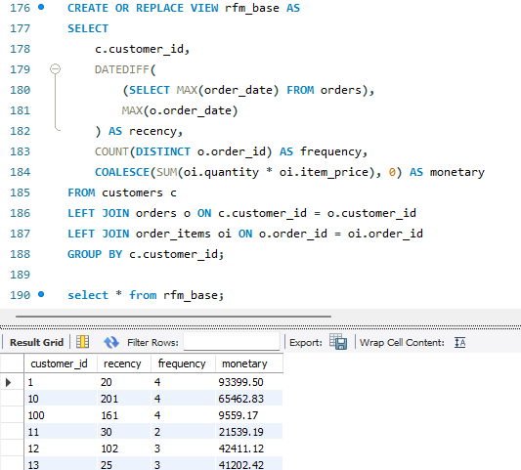
RFM_BASE
Rfm_base is the initial view which is created for calculating R(recency), F(frequency) and M(monetary) for each customer.

Slide 14
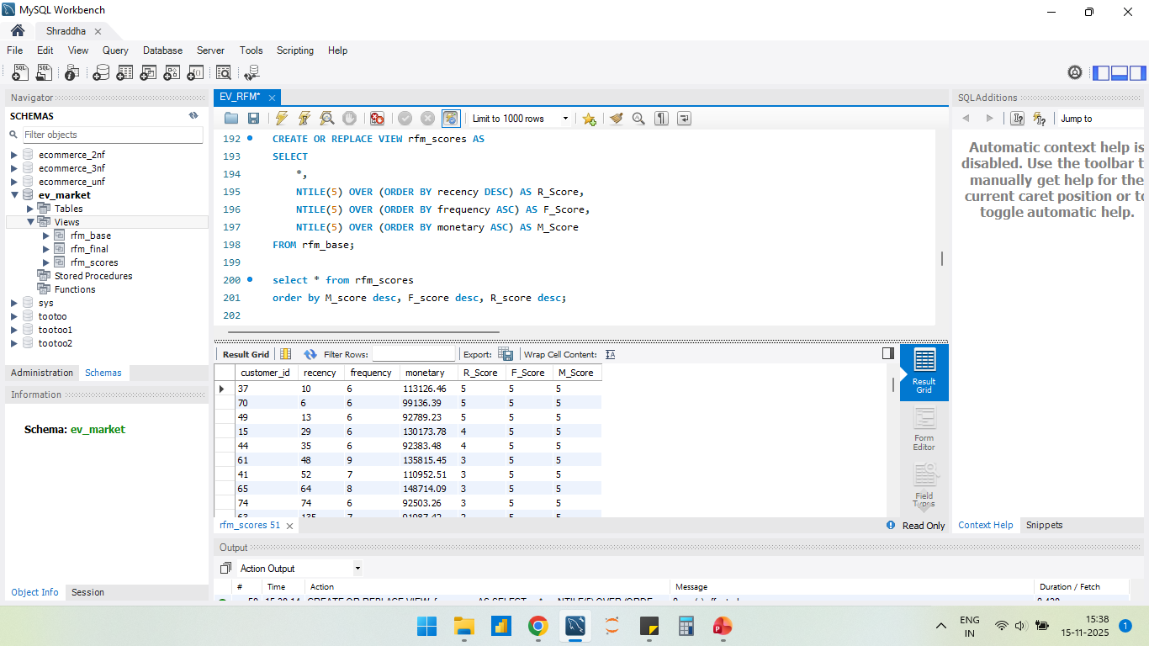
RFM_scores
Rfm_scores is created for calculating R_score, F_score and M_score for each customer using rfm_base virtual table.
NTILE(n) is a window function that divides the ordered rows into n equal buckets (tiles) and assigns each row a bucket number.

Slide 15
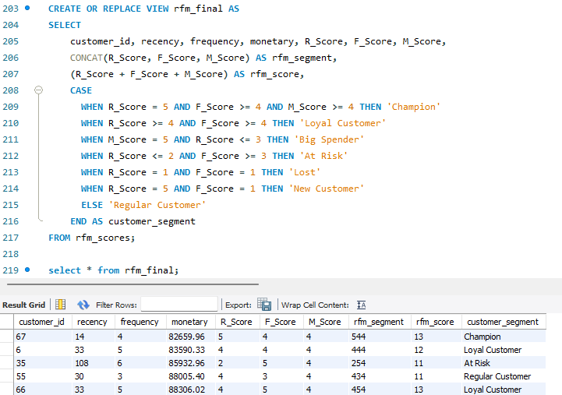
RFM_final
Rfm_final is created for segmenting the customers using rfm_scores virtual table.

Slide 16
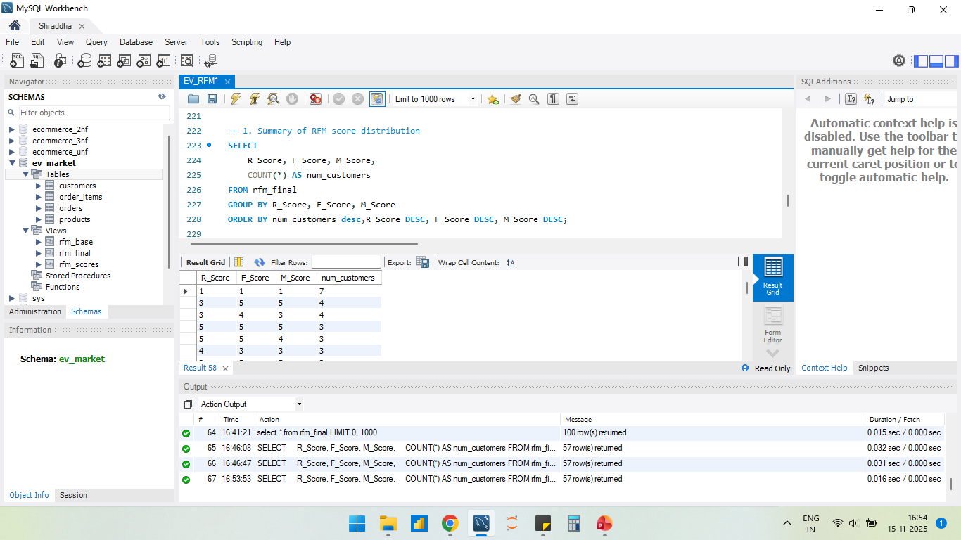
insights
The RFM distribution that the largest group (7 customers) are low-value and inactive. They haven’t engaged in a long time and contributed very little revenue. They represent the highest churn-risk segment.

Slide 17
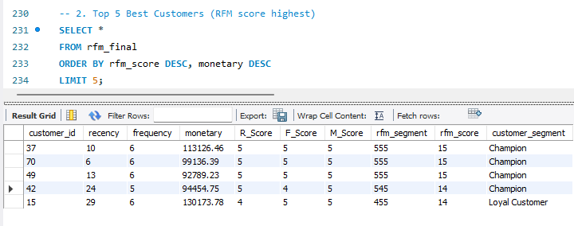
insights
3 customers with customer_ids 37,70,49 alone contribute a disproportional share of revenue and maintain consistent business with high-value EV-related purchases.The company can Offer premium plans or loyalty programs.
Customer_id 15 is a high-value repeat spender who has recently not purchased as frequently as the top 3 customers but remains highly loyal and profitable, spent ₹130,173, the highest among all Top 5 customers, despite not being most recent.

Slide 18
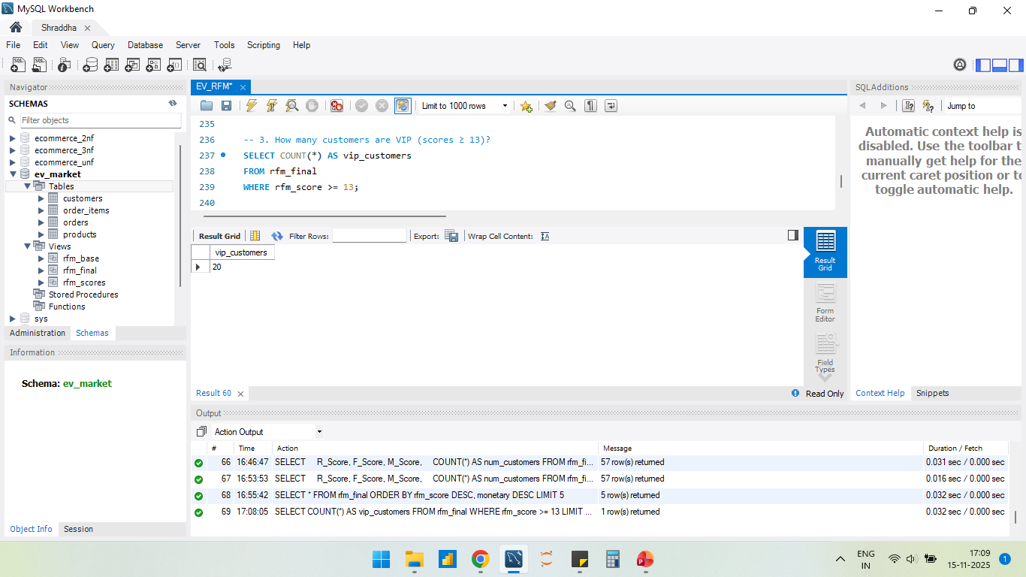
insights
A score ≥13 (out of 15) indicates excellent recent activity, high purchase frequency, and high monetary value.These customers are of top-tier segment—typically called Champions, Loyal Customers, High-Value Customers
Having 20 VIP customers means the company already have a reliable group that consistently drives revenue.

Slide 19
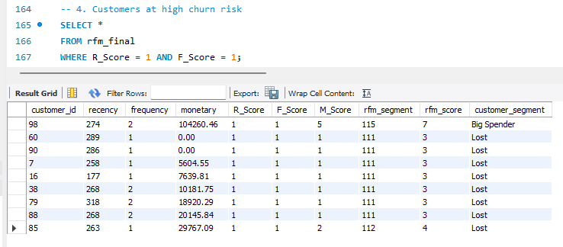
insights
These customers have not returned at all and have not purchased recently.
They are the lowest-value segment in terms of loyalty.
One of the customers who spent big but didn't return.

Slide 20
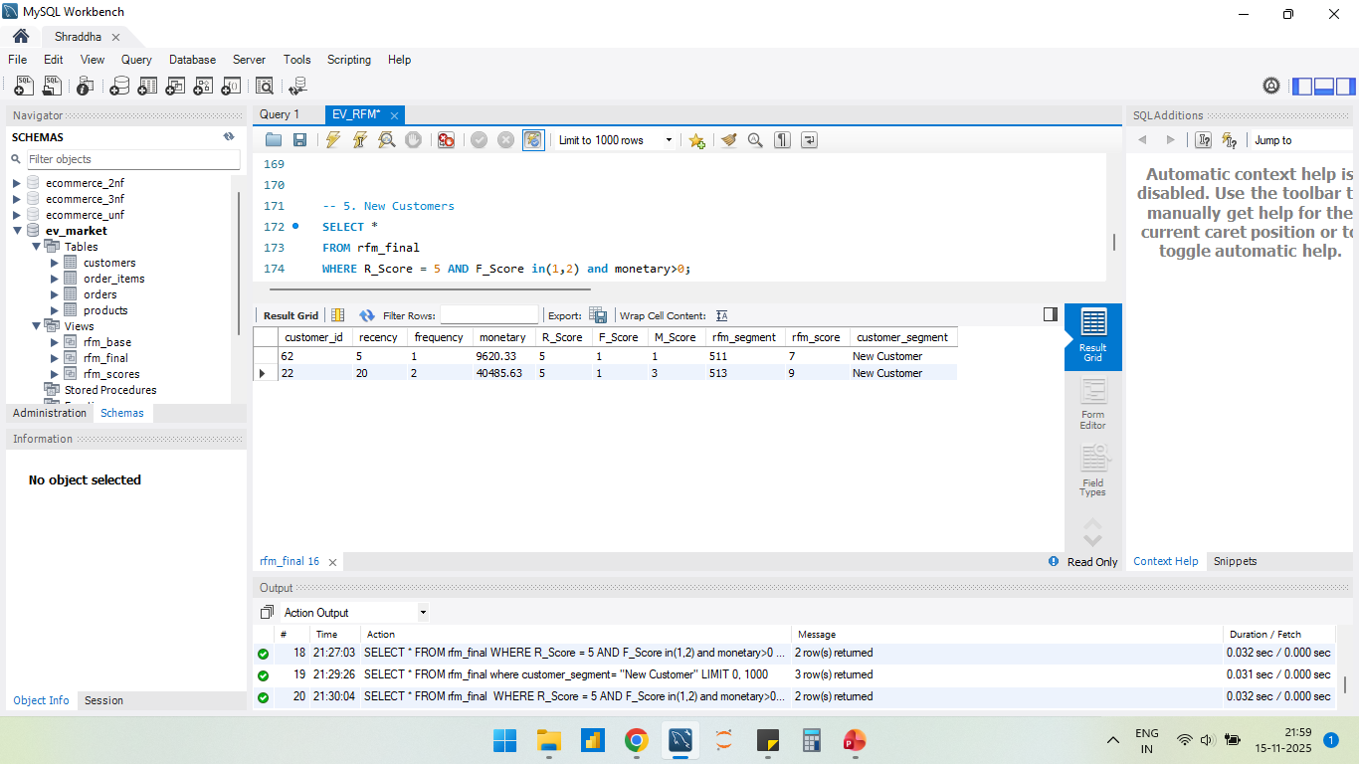
insights
There are two new customers who purchased recently once or twice.
These customers are not low-value test buyers; they are high-spending new customers. With the right nurturing, they can convert into loyal customers.

Slide 21
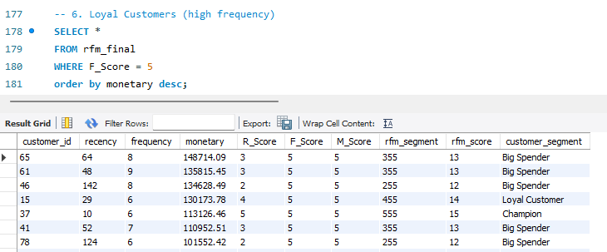
insights
The output shows 20 customers i.e, large loyal segment, which is a strong sign of customer health
They buy very frequently, spend high monetary value, also some are recent customers.
To retain less recent customers, can use Personalized offers or bundle recommendations or win-back programs.

Slide 22
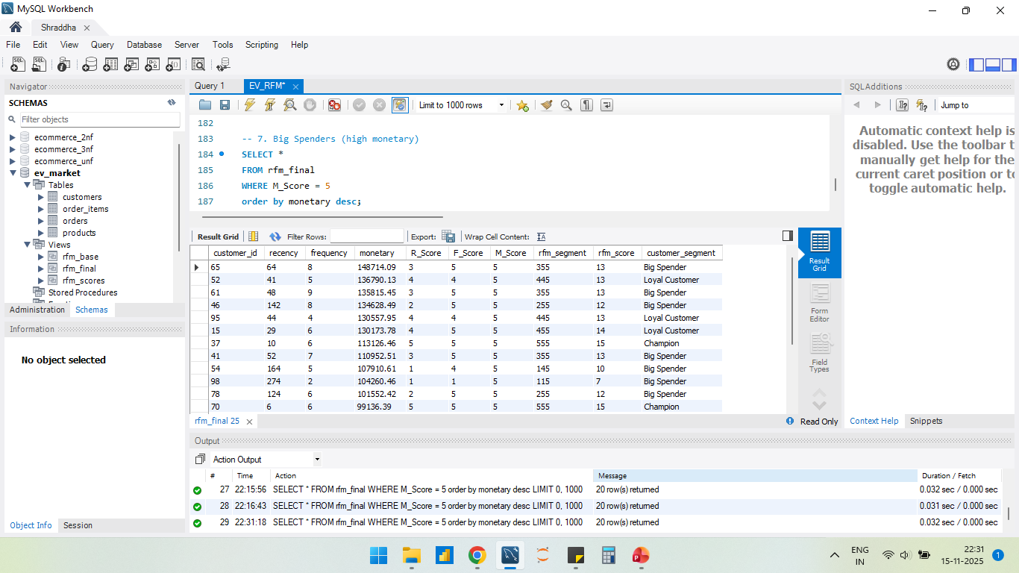
insights
The output shows 20 customers i.e, large big spender segment, which is a strong sign of revenue health
Here most of the customers buy frequently and recently,
But a few of them didn’t show up in recent times, so, here lies a possibility of churn.
To retain these less recent customers, company can use discount emails, service reminders or win-back programs.

Slide 23
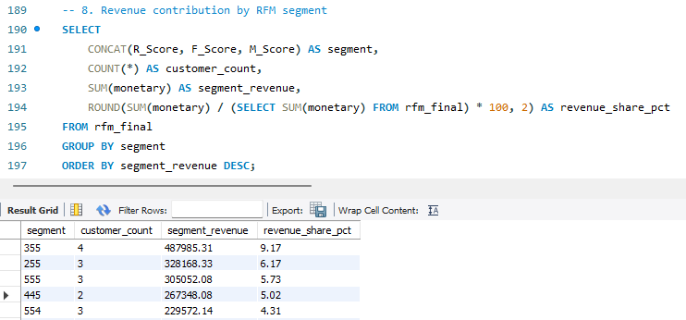
insights
The revenue share is highest for segment 355 means these 4 customers buy expensive items often , they are active but not very recent .

Slide 24
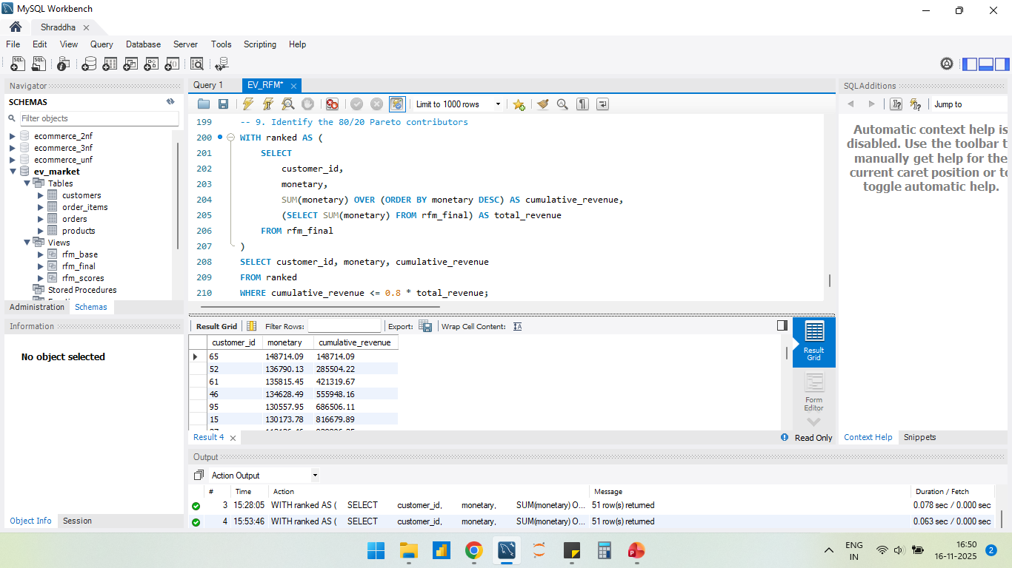
insights
There is a list of 51 customers who are the highest spenders, and together contribute to 80% of total revenue.
We can see how fast cumulative revenue rises with each customer and the revenue concentration also.
.

Slide 25
Thank You!
Check out this link below for the full assignment work :
https://github.com/ShraddhaSaha/RFM_Analysis
shraddhaasaha@gmail.com

